Slide 1
Identify acute intracranial hemorrhage and its subtypes from the CT study images
Machhindra Basnet
September 2019

Slide 2
Final Capstone
This Capstone corresponds to the final part of Thinkful Data Science Bootcamp. You can visit my notebook at
https://github.com/MachhindraBasnet/Thinkful-Challenges-and-Drills

Slide 3
Introduction
We have explored and modelled RSNA intracranial hemorrhage detection data set from recent Kaggle competition to identify acute intracranial hemorrhage and its subtypes from the CT study images of patients
The CT images can confirm bleeding and the evidence of trauma in head.
Correct diagnosis of presence of hemorrhage and its type looking at the radiological report helps timely and effective care
The dataset consists of CT studies of patients and the probability of whether the type of hemorrhage exists or not.
The objective is to build an algorithm that can detect hemorrhage and its type which could be a valuable information for the medical community to make data driven decisions.

Slide 4
Dataset Information
674258
The data consists of CT images as stage-1_train.zp and stage-1_test.zip
Consists of IDs of the patients and multiple labels, one for each of five sub-types of hemorrhage, plus an additional label for any, which should always be true if any of the sub-type labels is true
Used a random sample of 1000 images out of 674258 files from the train set for faster run time which was further splitted into train and evaluation sets for modelling
Used a Kaggle kernel for this project

Slide 5
Exploratory Data Analysis

Slide 6
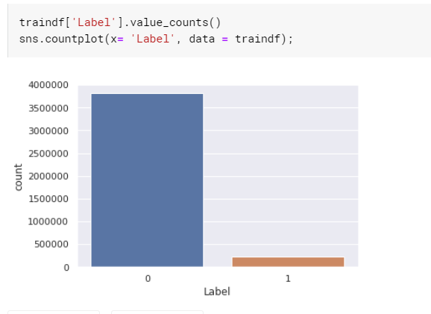
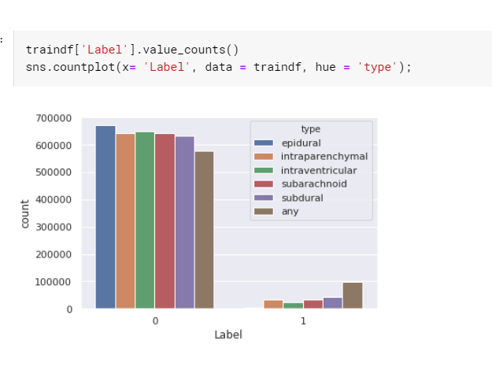
Data Visualization
Label, indicates the probability of whether that type of hemorrhage exists in the indicated image
Label ‘0’ represents that it not the type of hemorrhage and ‘1’ represents any of the type of hemorrhage
There are 5 different subtypes of hemorrhage and for type ‘any’ we made ‘yes’ and ‘no’ (if any of subtypes of hemorrhage exist in image then yes else no)
Can see data imbalance here for which we have balanced before modelling

Slide 7
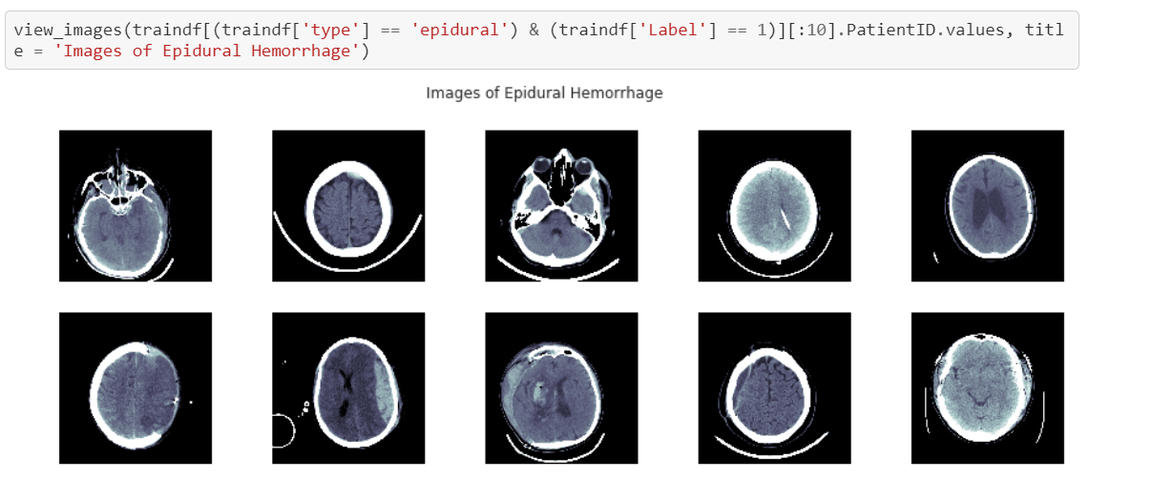
Image Visualization
Images were preprocessed using Pydicom
Rescaled, resized and converted the .dcm images to .png

Slide 8
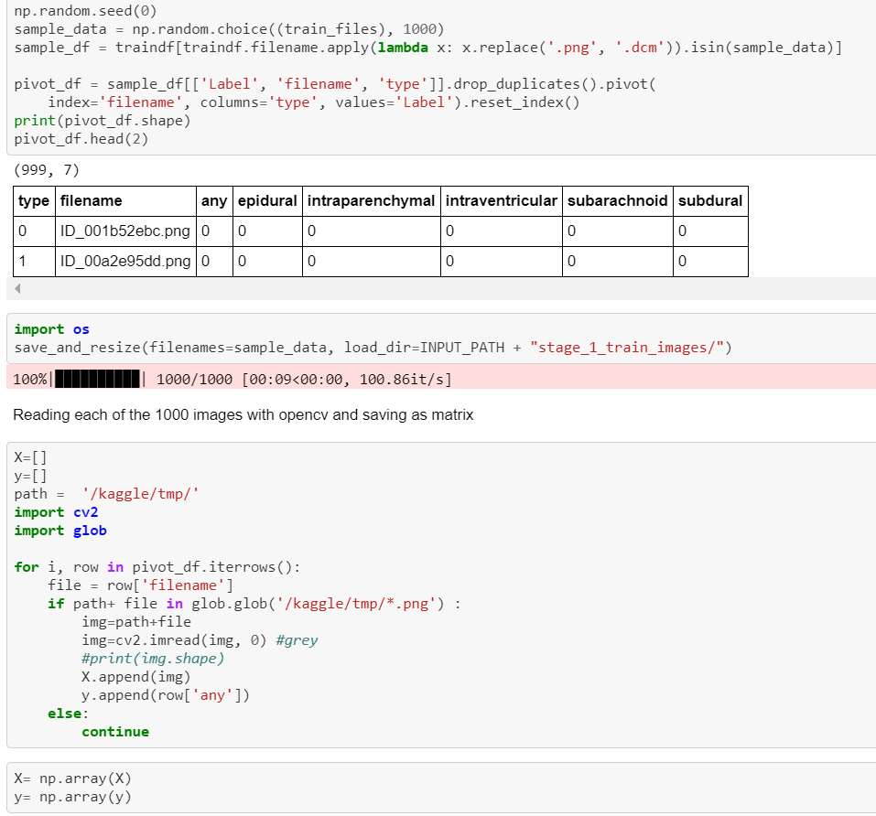
Feature engineering/selection
Used a random sample of 1000 images for faster run time (with more CPU, GPU we can use all images)
X (features) are the images which are converted to matrix (used cv2 which read image a greyscale)
Target (y) if the type ‘any’ which is converted to 1/0 as for every image it can either has one of the five types of hemorrhage -1 or none of them -0
The data was splitted to train and evaluation sets using train_test_split

Slide 9
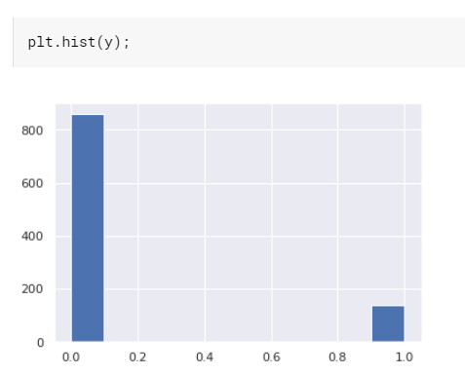
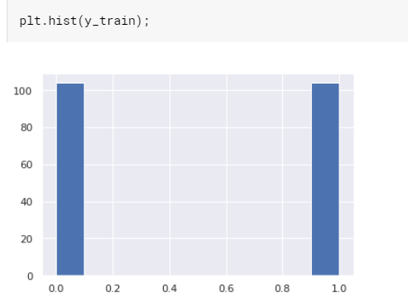
Handling data Imbalance
Balanced the data (train set) by under sampling the majority class (this is to save the computational time as well due to the limitation of CPU/GPU)

Slide 10
Model Training and Evaluation

Slide 11
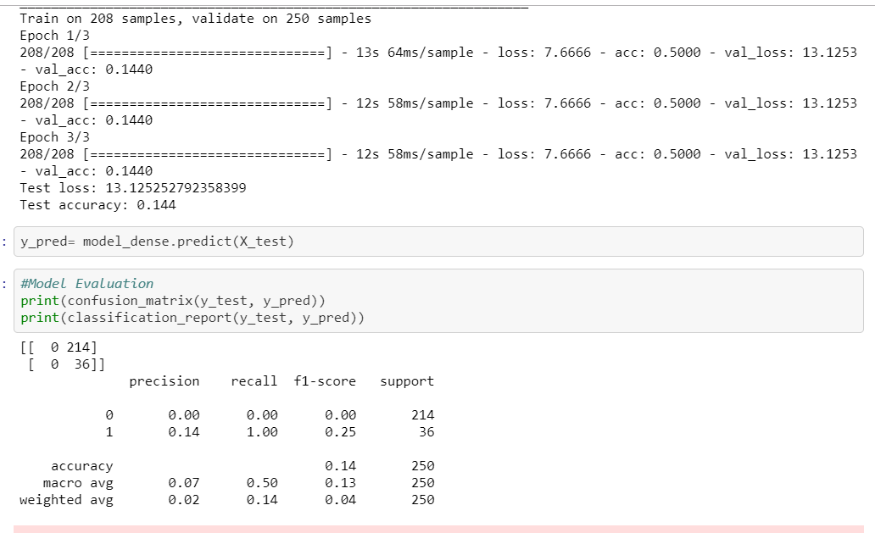
1. Dense Model
Dense model trained with 3 iterations
Accuracy of 14% with loss of approx. 13%
Model not predicting for 0 (images not having hemorrhage)

Slide 12
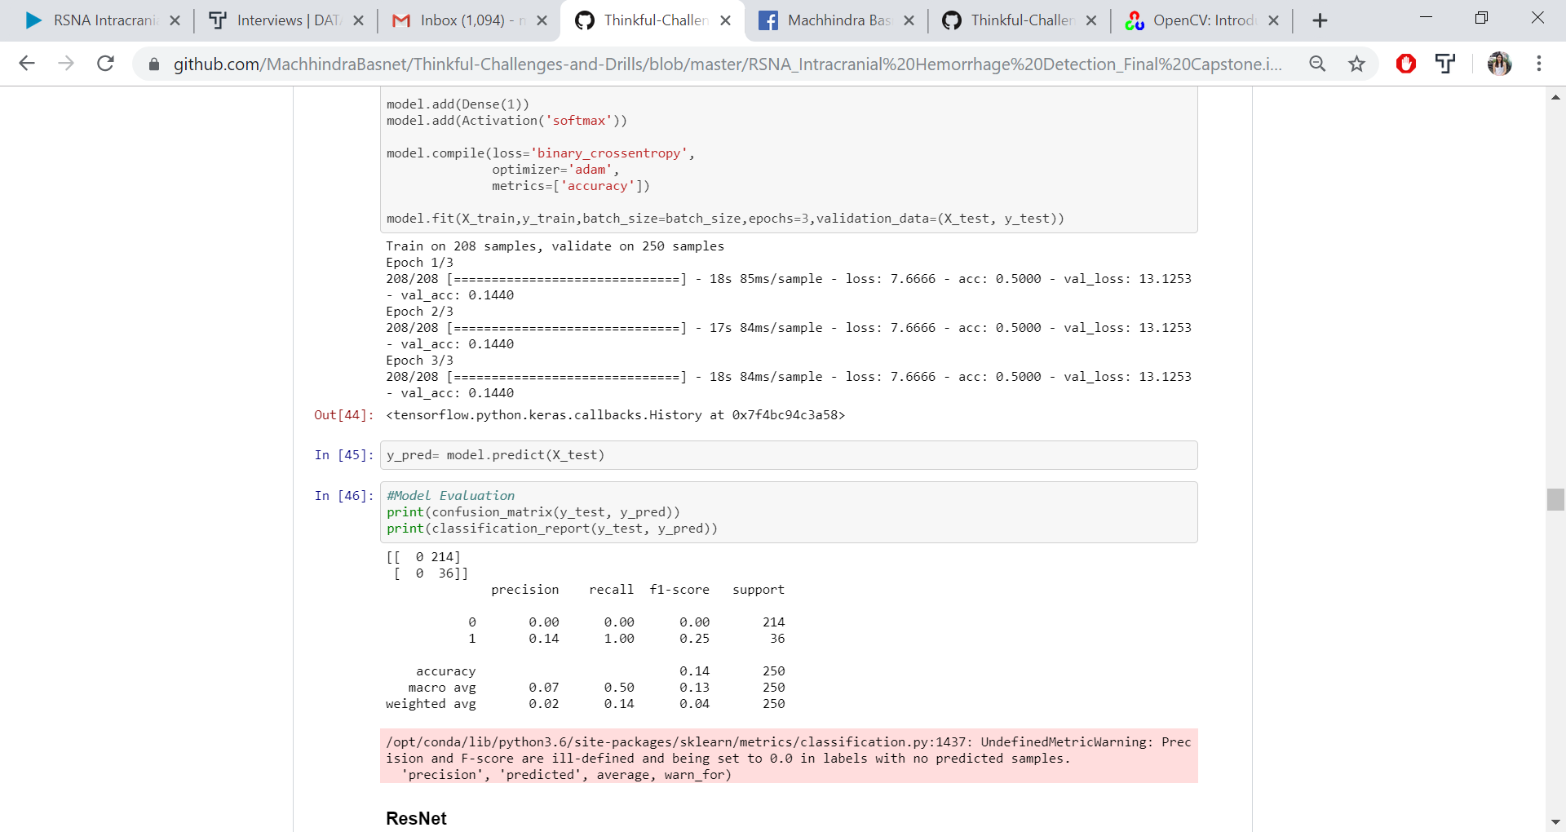
2. Convolutional Neural Network(CNN)
CNN model with 3 iterations
Accuracy of 13% with loss of 14%
Model not predicting for 0

Slide 13
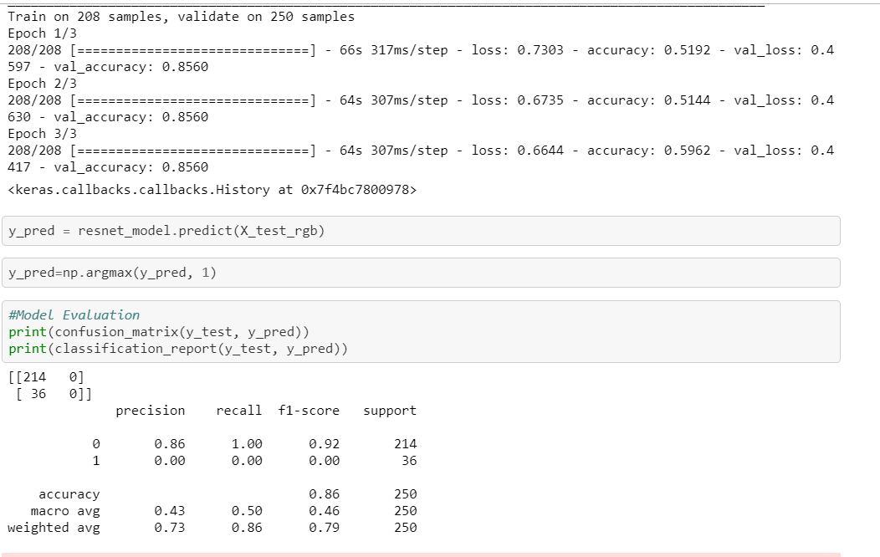
3. ResNet
Model with 3 iterations
Accuracy of 85% with loss of 44%

Slide 14
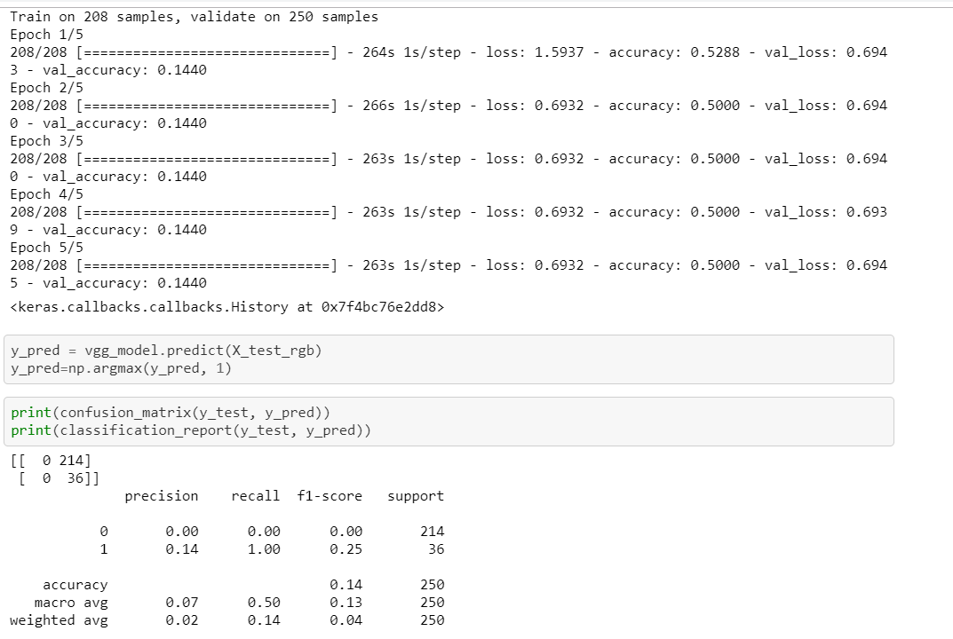
4. VGG Model
VGG model with 5 iterations;
Accuracy of 14% with loss of 69%
Model not predicting for 0

Slide 15
Conclusions
We have created workable pipelines to preprocess dcm data and fit into several CNNs
The models haven't led to useable results due to the limitation on computational power

Slide 16
Next Steps
Train models on AWS/google cloud using more images (with augmentation) as input
Try fastai and other pretrained models
Compare model performance
Create front end tool/app for users to interact with the model results

Slide 17
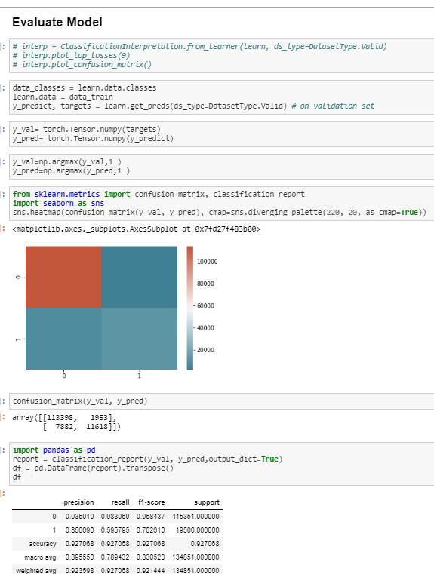
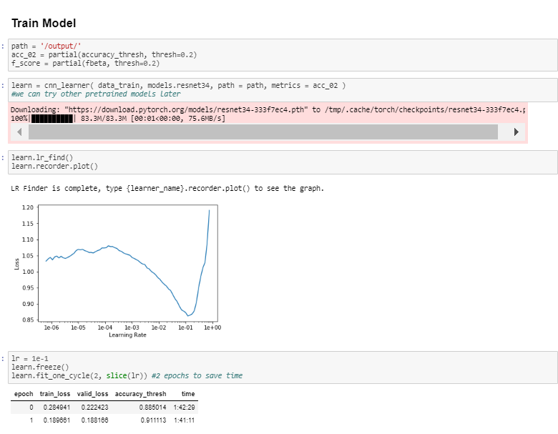
Fastai Achieved 59% recall with Resent34 Type II error is high Next Steps Try other pretrained models and grid search with more epochs

Slide 18
Thank you!

